Slide 1
Engineering centre of expertise:
Manufacturing engineering
Contact: Olivier WIKSZAK – olivier.wikszak@segulagrp.com

Slide 2
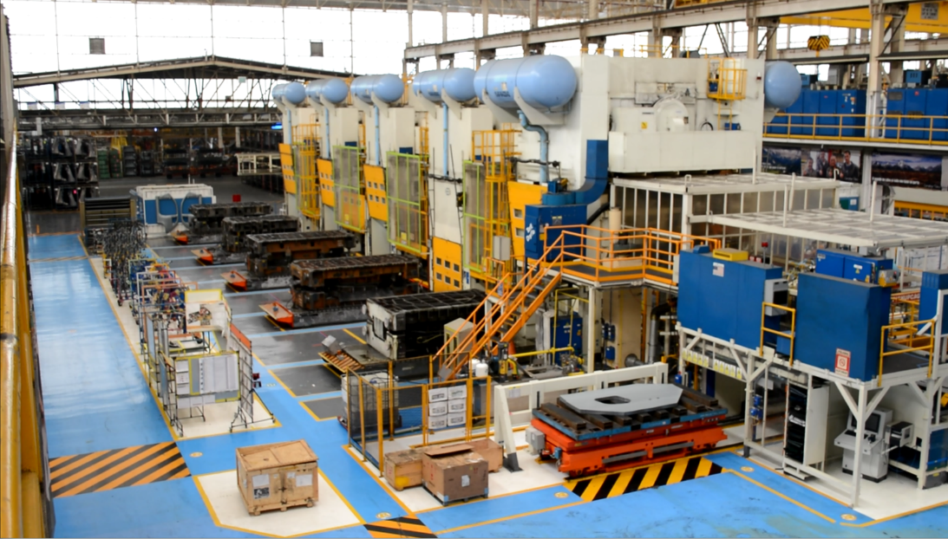
Stamping
Smart Car program
Chennai (India)
Trnava (Slovakia)
Kragujevac (Serbia)
Project scope
2020-2025
Introduction of 3 new car models in Trnava plant (ICE, BEV & MHEV) and 2 new models in Kragujevac plant (ICE, BEV & MHEV)
Complete process engineering from design to start of production (Slovak and Serbian teams)
7 people in studies and industrialisation
Activities
Quality
Tooling
Organisation:
Project management (Slovakia)
Studies and industrialisation (India + Slovakia + Serbia)

Slide 3
Welding & Painting
Smart Car program
Chennai (India) Trnava (Slovakia)
Project scope
2020-2025
Introduction of 3 new car models in Trnava plant (ICE, BEV & MHEV)
Complete process engineering from design (Indian specifications) to start of production (Slovak team)
10 people in studies & industrialisation
Activities
Welding: Time analyst, Equipment
Painting: Preparation
Organisation:
Project management and coordination team (Slovakia + India)
Studies phase (Slovakia + India)
Industrialisation (Slovakia)

Slide 4
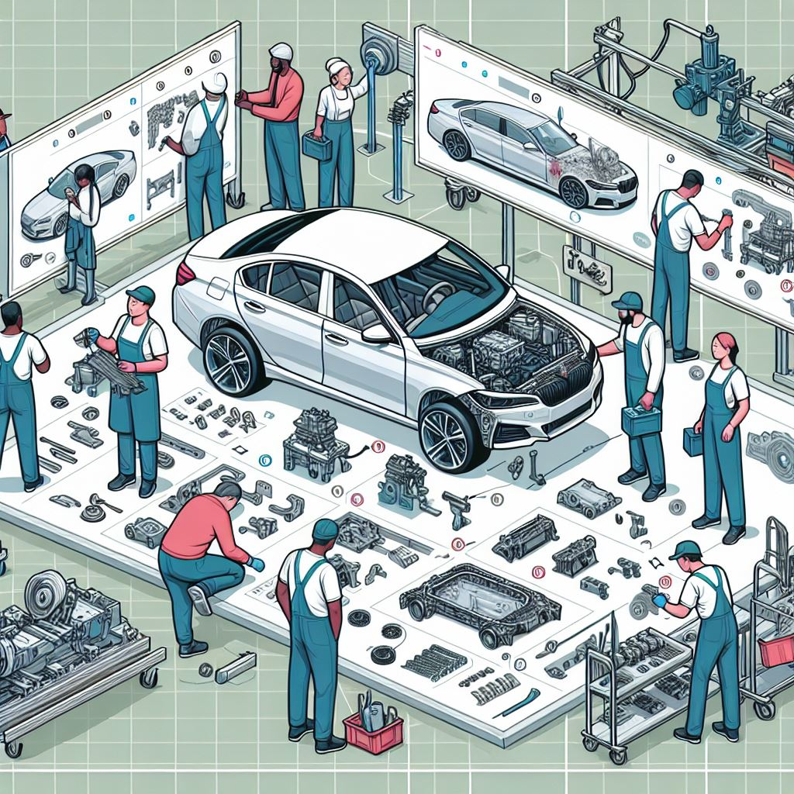
Process engineering
Chennai (India), Trnava (Slovakia), Kragujevac (Serbia), Zaragoza (Spain), Russleshiem (Germany), Brazil, Kenitra (Morocco), Sochaux (France), Melfi (Italy)
Project scope
General Assembly Process Engineering for STELLANTIS plants in 9 countries in Europe for new vehicle projects and serial life.
+40 industrial projects
13 European plants
2020-2026
50 people in front office
30 people in back office
Activities
Process sheet creation (study and industrial phase)
Time analysis
Ergonomic studies
Overall responsibility to ensure process sheet book creation
Work with plant, design and equipment teams
Organisation:
Project management and coordination team (Slovakia + India)
Study phase (Slovakia + India)
Industrialisation (Germany, Spain + Serbia)

Slide 5
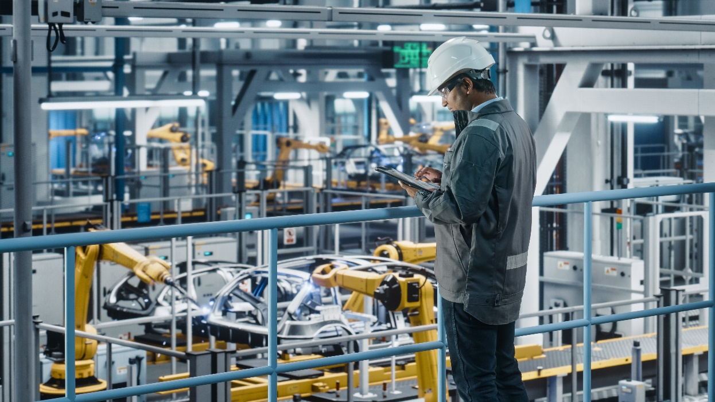
Equipment engineering
Trnava (Slovakia) front office coordination, Chennai (India) back office, industrialisation countries (PL, DE, SP, UK, IT, SRB, FR, SK)
Project scope
General Assembly Process Engineering for STELLANTIS plants in 9 countries in Europe for new vehicle projects and serial life.
+40 industrial projects
13 European plants
+1000 equipment contracts
2021-2026
40 people in studies
75 people in industrialisation
Activities
Transversal activity for a new and carryover equipment for general assembly
Organisation:
Project management and coordination team (Slovakia)
Studies phase (industrialisation countries + India)
Industrialisation (Europe)

Slide 6
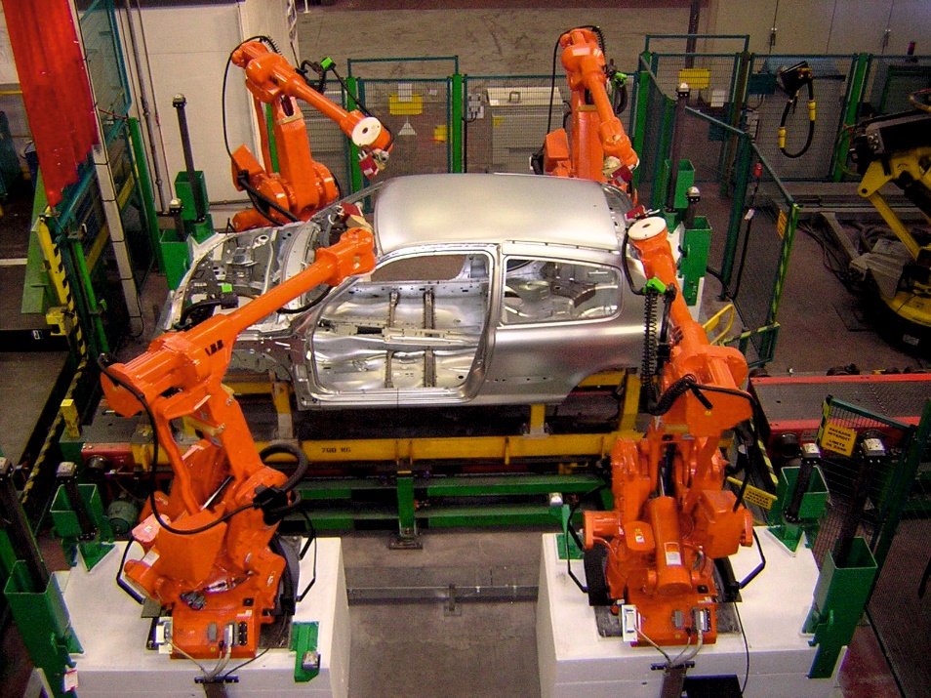
Automation, Handling and AGV
Smart Car program
Trnava (Slovakia)
Kragujevac (Serbia)
Project scope
2020-2025
Introduction of 3 new car models in Trnava plant (ICE, BEV & MHEV) and 2 new models in Kragujevac plant (ICE, BEV & MHEV)
Complete process engineering from design to start of production (Slovak and Serbian teams)
20 people in studies and industrialisation
Activities
Welding automation and handling
Painting automation and handling
Final assembly automation, handling and AGV
Organisation:
Project management (Slovakia)
Studies and industrialisation (Slovakia + Serbia)

