Slide 1
Engineering centre of expertise:
Product and Geometry engineering
Contact: Dhananjay ADWANDKAR - dhananjay.awandkar@segulagrp.com

Slide 2
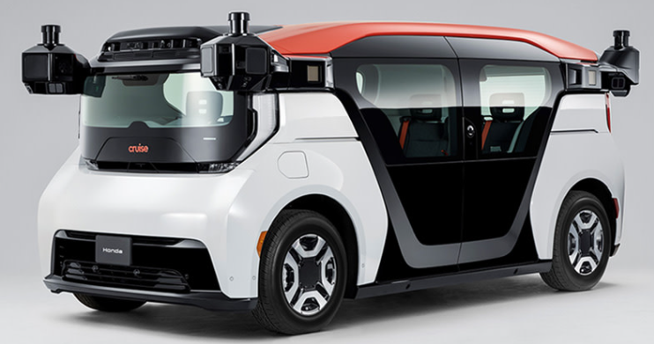
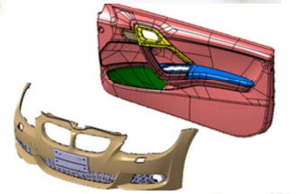
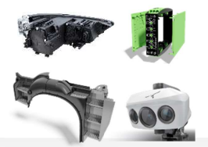
Product Design and development
Back Office : Tunisia and Morocco
Front Office : Trnava (Slovakia)
Project scope
2021-2022
Product design and CAD support to Tier Plastic Omnium – Bumper design for USA OEM - Project Cruise , RSA and PSA .
Development support to ZKW Lighting – Front and Rear lights for the BMW , Volvo and PSA .
13+ people – Design & CAD.
Activities
OUR ADDED VALUE
Technical convergence with style and Feasibility study. – Exterior and Interior parts
Design and CAD support – (Catia ) Onsite and offshore .
Product and process conformity monitoring .
Process Tooling injection / Follow up
Supplier convergence.
Global approach .
Multi-national and young dynamic team .
Multi-OEM expertise .
Mixed experience with seniority.

Slide 3
Geometry - Welding and (BCIQ) body chassis & interiors, quality)
Project scope
Back Office : Chennai (India),
Front Office Trnava (Slovakia), Kragujevac (Serbia)
Complete geometry engineering support from product and process - geometry design / development to SOP.
Supplier management with all product as per geometry needs.
Secure Launch of the vehicles with aesthetic and functional quality.
2020-2025
14 People in studies and design.
95 People in industrialisation.
Activities
Product and process conformity monitoring .
Geometrical quality assurance.
Supplier convergence.
Jig and Fixture geometry assurance on the welding tools for the parts.
Organisation:
Conception and design phase (offshore – back office )
Industrialisation (Onsite in the plant )
OUR ADDED VALUE
Global approach .
Multi-national and young dynamic team .
Multi-OEM expertise .
Mixed experience with seniority.
Flexible team in the field to adopt the role in the geometry area.

Slide 4
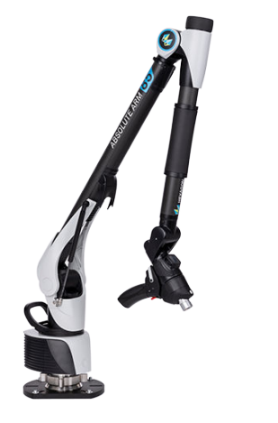
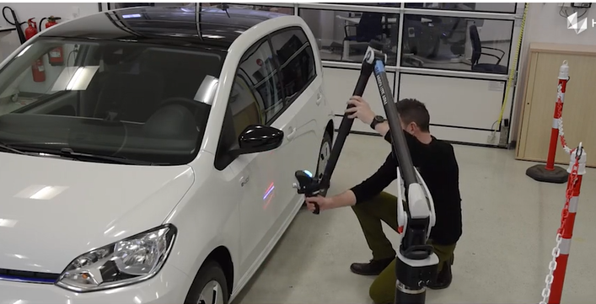
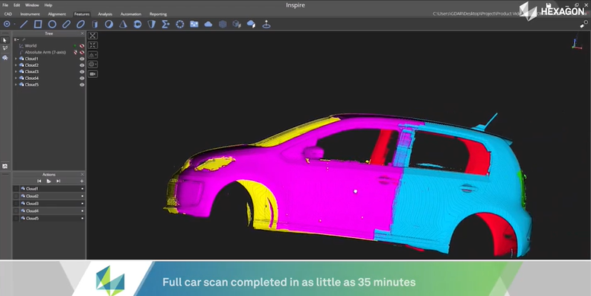
Metrology with Scan arms
Project scope
Metrology measurements – scan / reports with Hexagon scan arm and highlight the assembly defects .
For the mapiex/cubing and assembly parts scanning.
Assembly and welding dept. support for scanning parts and reports with Polywork software .
Hexagon - ABSOLUTE 8535 - 7 axes + scanner AS1
Trnava (Slovakia), Kragujevac (Serbia)
2020-2024
8 people Metrologist
4 people Project Planning
Activities
OUR ADDED VALUE
Metrology investigations scanning and reports support for the parts .
Geometrical quality assurance with metrology scope .
Supplier convergence for defective parts.
Expertise team support on the Polywork software .
Global approach
Polywork Expertise team.
Knowledge with Scan arm handling .
Availability of the 2 Qty scan arms to support the any region with skilled engineers .

